Slide 1

Backup Basics with dbatools

Slide 2
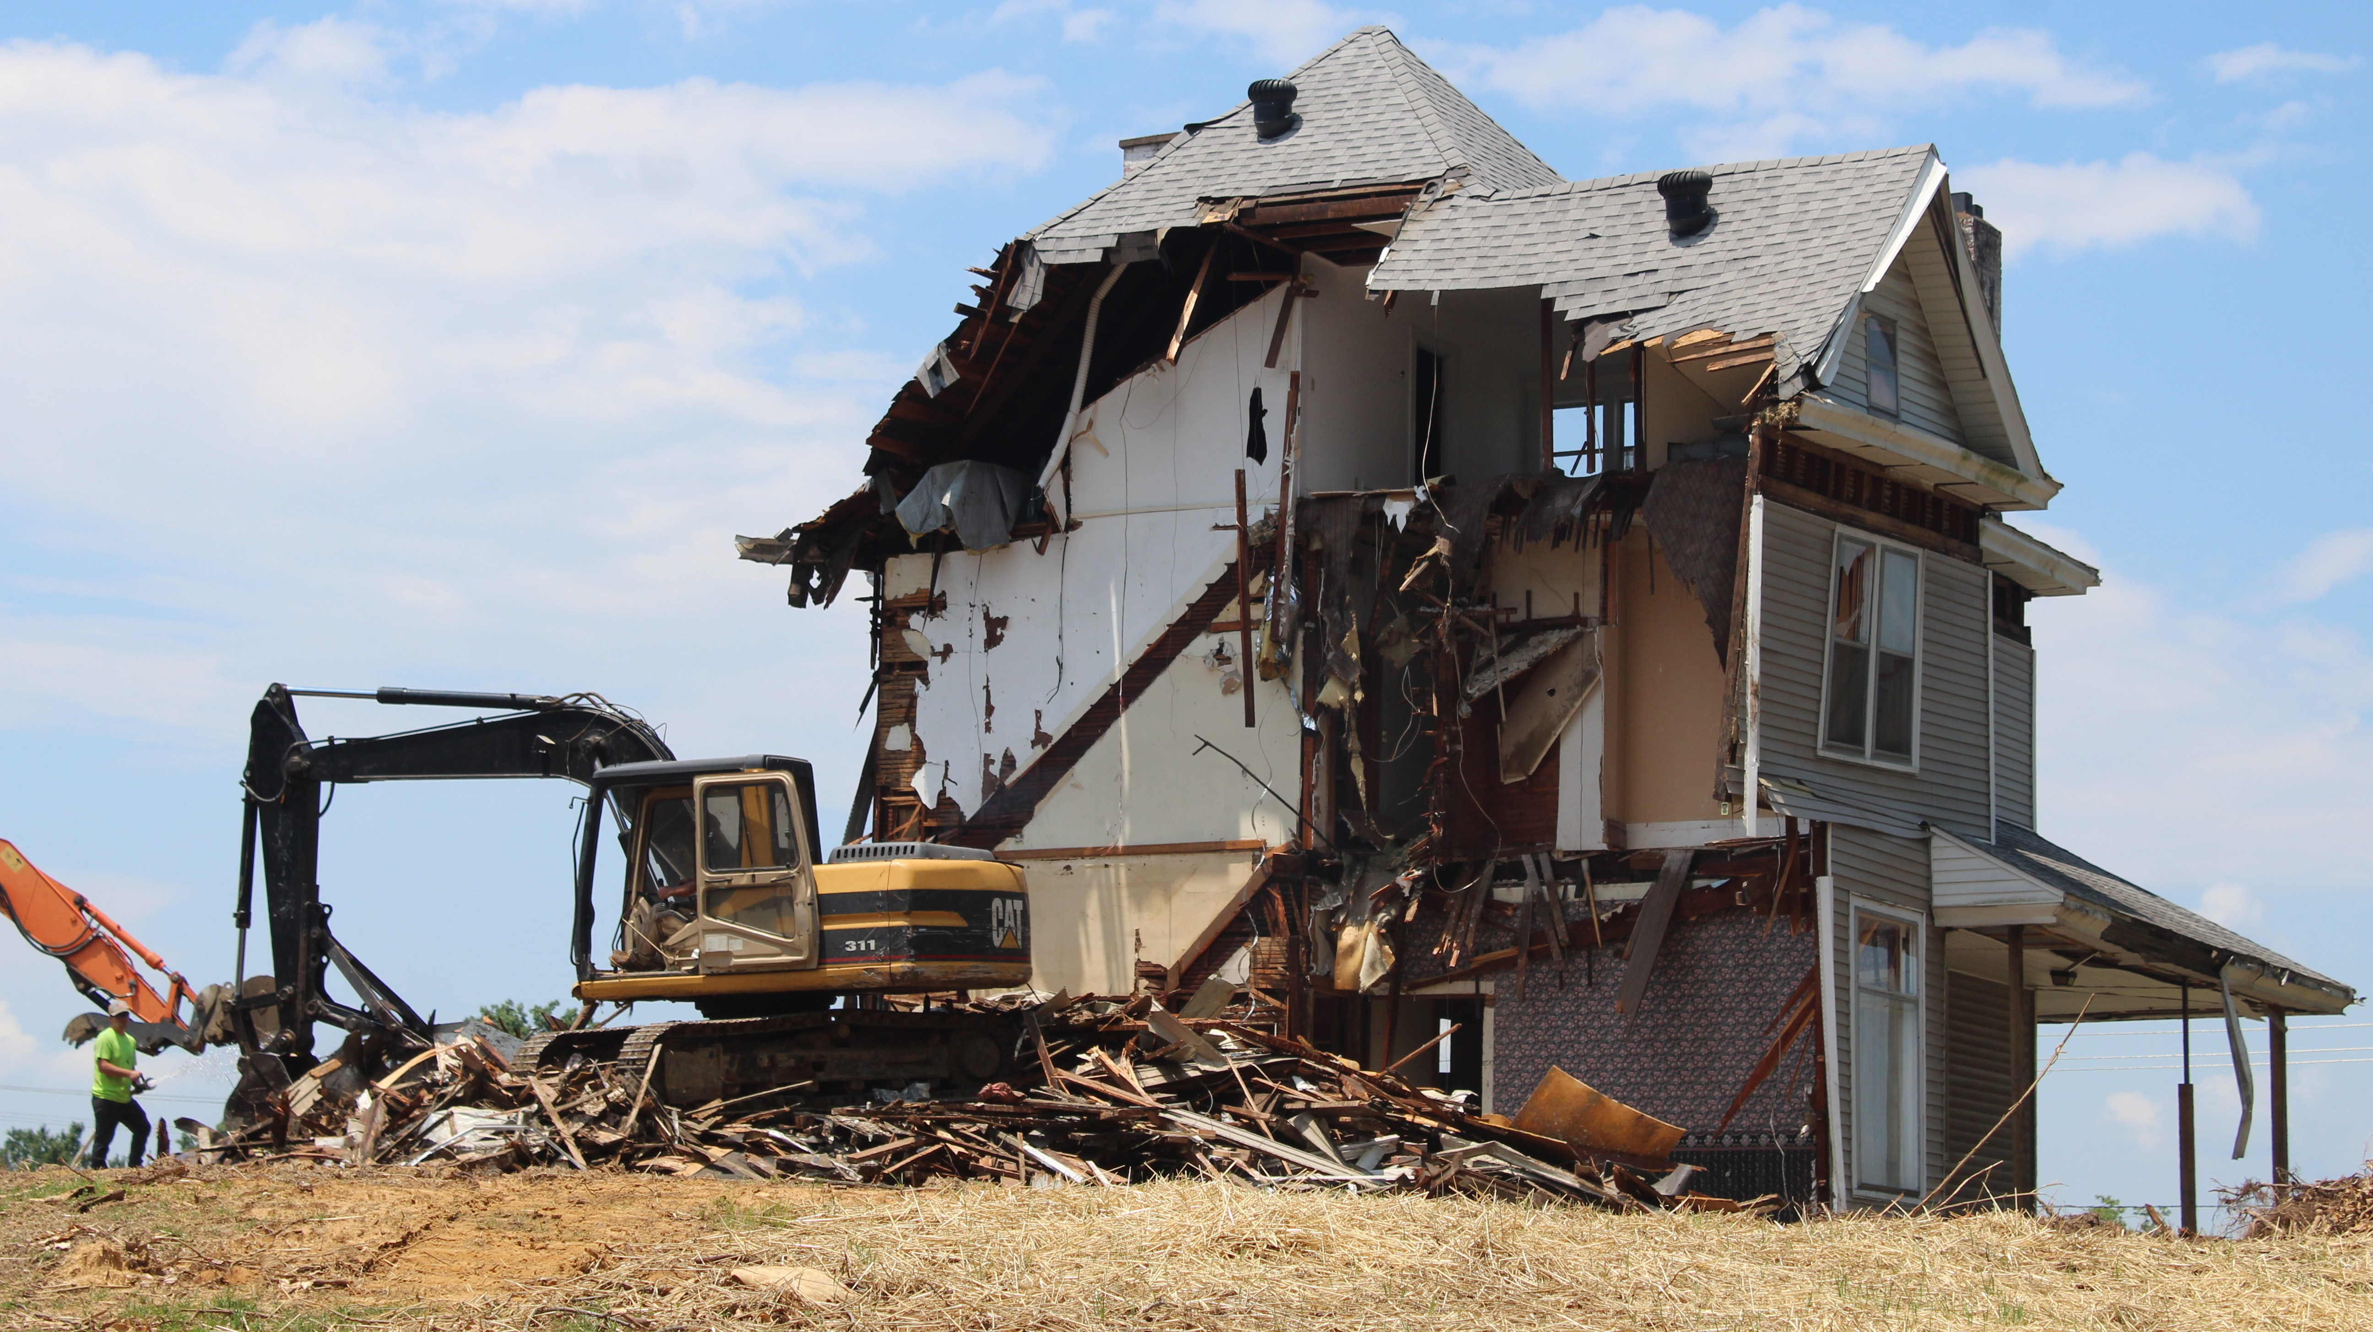
Demo Time!
Notes:
https://unsplash.com/photos/ivHVZCmm5wY

